Slide 1
Chapter 3
How to use HTML to structure a web page

Slide 2
Objectives
Applied
Code a properly structured HTML web page using the semantic elements and any of the other elements that are presented in this chapter.
Given the folder structure for a website, code a relative URL that refers to any file in that structure.
Knowledge
Describe the use of the title and meta elements in the head section of an HTML document.
Distinguish between a block element and an inline element.
Describe the use of these block elements: h1, h2, h3, and p.
Describe the use of these semantic elements: header, main, section, article, nav, aside, footer, and figure.

Slide 3
Objectives (continued)
Describe the use of the div element in the HTML for a modern website.
Describe the use of these inline elements: q, em, strong, sub, sup, span.
Describe the use of character entities like &nbsp; or &copy;.
Distinguish between absolute and relative URLs, and distinguish between root-relative and document-relative paths
Describe the use and accessibility guidelines for <a> elements.
Describe the two types of lists that you can create with HTML.
Describe the use and accessibility guidelines for img elements.

Slide 4
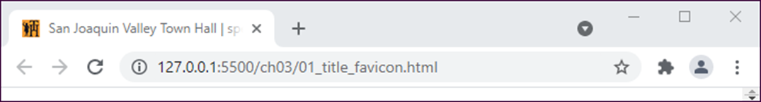
A browser that shows the title and favicon
A head section with a title and a link to a favicon
<head>
<title>San Joaquin Valley Town Hall | speakers and luncheons
</title>
<link rel="shortcut icon" href="favicon.ico">
</head>

Slide 5
A head section that includes metadata
<head>
<title>San Joaquin Valley Town Hall | speakers and luncheons
</title>
<meta charset="utf-8">
<meta name="description" content="A yearly lecture series with speakers that present new information on a wide range of subjects">
<meta name="keywords" content="san joaquin, town hall, speakers, lectures, luncheons">
</head>

Slide 6
SEO guidelines for the title tag
Always code a title tag in the head section.
The title should accurately describe the page’s content.
The title should include the one or two focus keywords that you want to be used for ranking the page.
The title should be interesting enough to entice the reader to click on it when it’s shown in the search results for a search engine.
The title should be unique for each page in your website.
Limit the length of your titles to around 65 characters because most search engines don’t display more than that in their results.

Slide 7
SEO guidelines for the meta tags
Code the description metadata for each page of your website.
The description should summarize the contents of the page, it should be unique for each page, and it can be longer than the title tag.
When the description is displayed in the search-engine results, it should encourage users to click on your link.

Slide 8
HTML that uses block elements
<h1>San Joaquin Valley Town Hall Programs</h1>
<h2>Pre-lecture coffee at the Saroyan</h2>
<p>Joins us for a complimentary coffee hour, 9:15 to 10:15 a.m. on the day of each lecture. The speakers usually attend this very special event.</p>
<h2>Post-lecture luncheon at the Saroyan</h2>
<p>Extend the excitement of Town Hall by purchasing tickets to the luncheons</p>

Slide 9
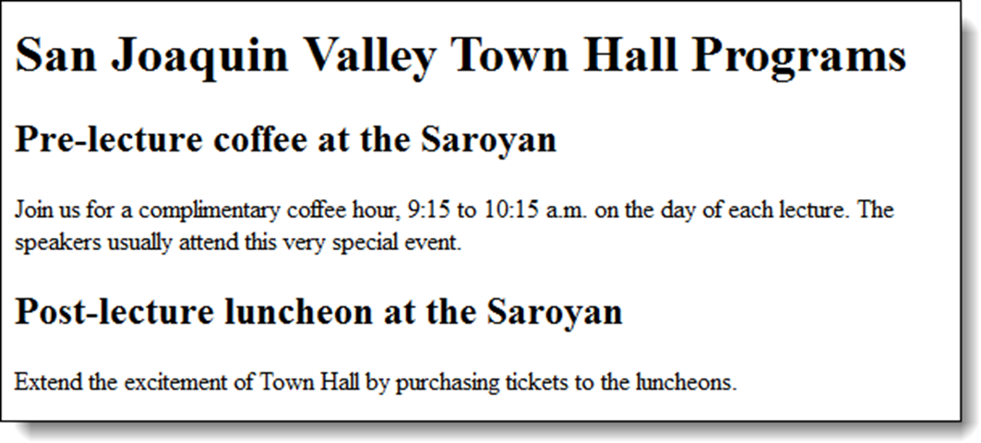
The block elements in a web browser

Slide 10
SEO guidelines for heading tags
Use the heading tags to show the structure and importance of the content on a page.
Always use the h1 tag to identify the most important information on the page, and only code a single h1 tag on each page.
Then, decrease one level at a time to show subsequent levels of importance.
Don’t use heading levels as a way to size text. Instead, use CSS to size the headings.

Slide 11
An HTML page with structural elements
<body>
<header>
<h1>San Joaquin Valley Town Hall</h1>
</header>
<main>
<p>Welcome to San Joaquin Valley Town Hall. We have some fascinating speakers for you this season!</p>
</main>
<footer>
<p>&copy; Copyright 2022 San Joaquin Valley Town Hall.</p>
</footer>
</body>
Accessibility and SEO guideline
Use the HTML structural elements to indicate the structure of your pages.

Slide 12
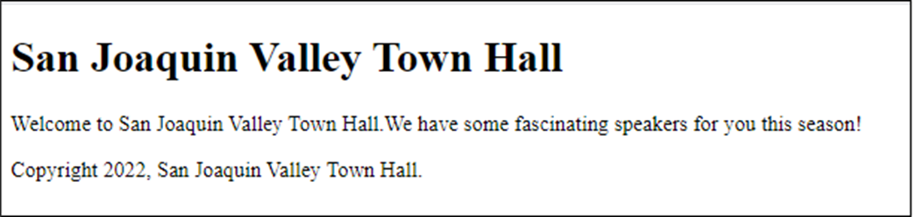
The page displayed in a web browser

Slide 13
How to use div elements to structure the content within a section
<section>
<div>
<h2>The first priority</h2>
<p>The elements for the first priority</p>
</div>
<div>
<h2>The second priority</h2>
<p>The elements for the second priority</p>
</div>
</section>

Slide 14
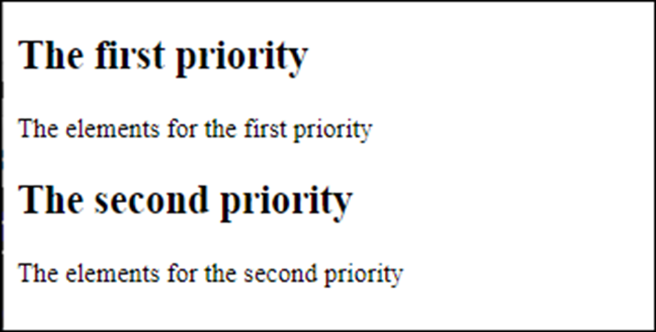
The resulting web page

Slide 15
How div elements were used before HTML5
<body>
<div id="header">
<h1>San Joaquin Valley Town Hall</h1>
</div>
<div id="main">
<p>Welcome to San Joaquin Valley Town Hall.</span> We have some fascinating speakers for you this season!</p>
</div>
<div id="footer">
<p>&copy; Copyright 2015 San Joaquin Valley Town Hall.</p>
</div>
</body>
Accessibility and SEO guidelines
Only use div tags when the HTML semantic elements don’t apply.

Slide 16
HTML that uses inline elements to identify and format text
<p>When the dialog box is displayed, enter <kbd>brock21</kbd>.</p>
<p>To quote Hamlet:
<q>Conscience does make cowards of us all.</q>
</p>
<p>If you don't get 78% or more on your final, <em>you won't pass.</em></p>
<p>Save a bundle at our <strong>big yearend sale</strong>.</p>
<p>The chemical symbol for water is H<sub>2</sub>O.</p>

Slide 17
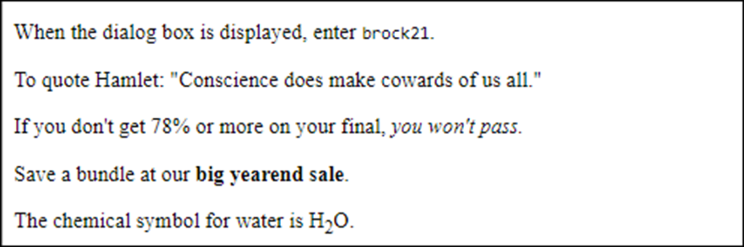
The inline elements in a web browser

Slide 18
HTML that uses block elements and character entities
<p>Ernest Hemingway wrote:</p>
<blockquote>
Cowardice, as distinguished from panic, is almost
always simply a lack of ability to suspend
the functioning of the imagination.
</blockquote>
<address>1-800-221-5528<br>
<a href="emailto:murachbooks@murach.com">
murachbooks@murach.com</a>
</address>
<p>&copy; 2022 Mike Murach &amp; Associates, Inc.</p>

Slide 19
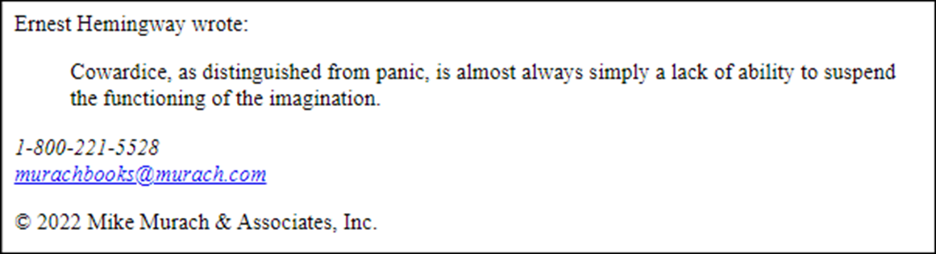
The block elements and character entities in a web browser

Slide 20
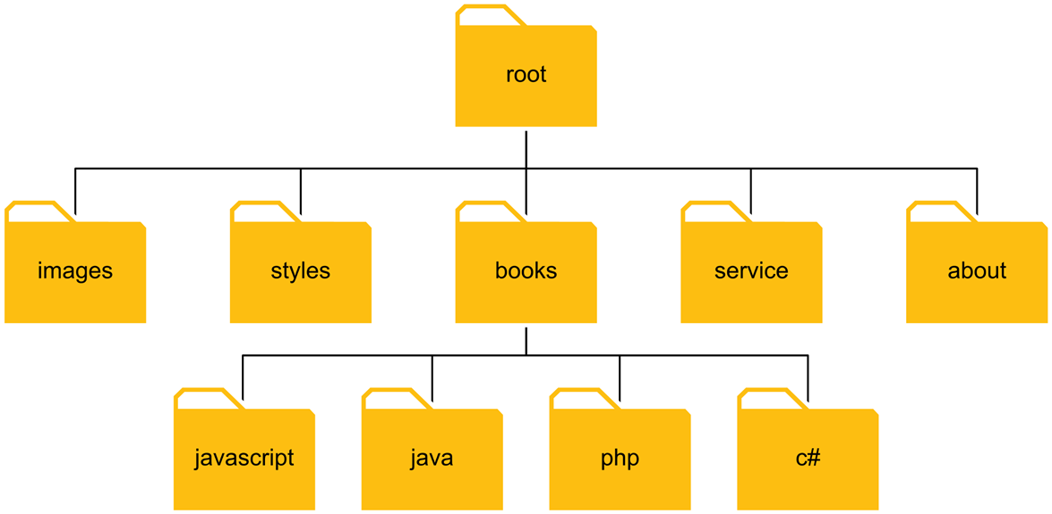
A simple website folder structure

Slide 21
Working with URLs and paths
Absolute URLs
http://www.murach.com/index.html
http://www.murach.com/books/php/toc.html
Root-relative paths
/login.html
/images/logo.gif
Document-relative paths that navigate down
images/logo.gif
books/php/overview.html
Document-relative paths that navigate up
../index.html
../images/logo.gif

Slide 22
Link examples
A link to a web page in the same folder
<p>Go view our <a href="products.html"> product list</a>.</p>
A link to a web page in a subfolder of the parent folder
<p>Read about the <a href="../company/services.html"> services we provide</a>.</p>
A link to a web page based on the root folder
<p>View your <a href="/orders/cart.html"> shopping cart</a>.</p>
A link to a web page at another website
<p>To learn more about JavaScript, visit the
<a href="http://www.javascript.com/"> official JavaScript web site</a>.</p>

Slide 23
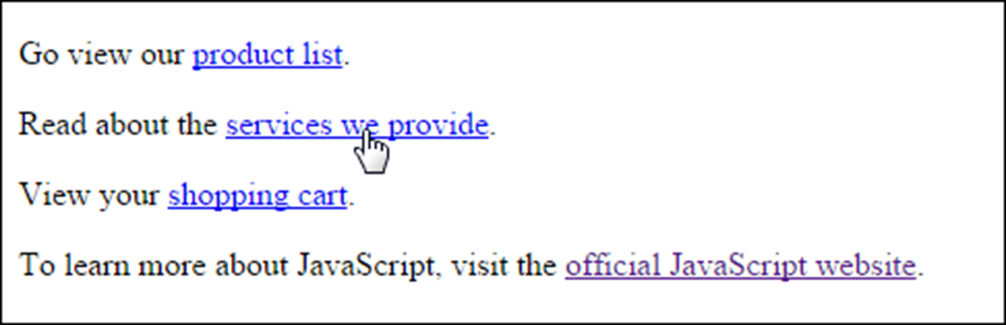
The link examples in a web browser
SEO and accessibility guideline for links
The content of a link should be text that clearly indicates where the link is going.

Slide 24
HTML that creates two lists
<p>We have books on a variety of languages, including</p>
<ul>
<li>JavaScript</li>
<li>PHP</li>
<li>Java<li>
<li>C#</li>
</ul>
<p>You will need to complete the following steps:</p>
<ol>
<li>Enter your billing information.</li>
<li>Enter your shipping information.</li>
<li>Confirm your order.</li>
</ol>

Slide 25
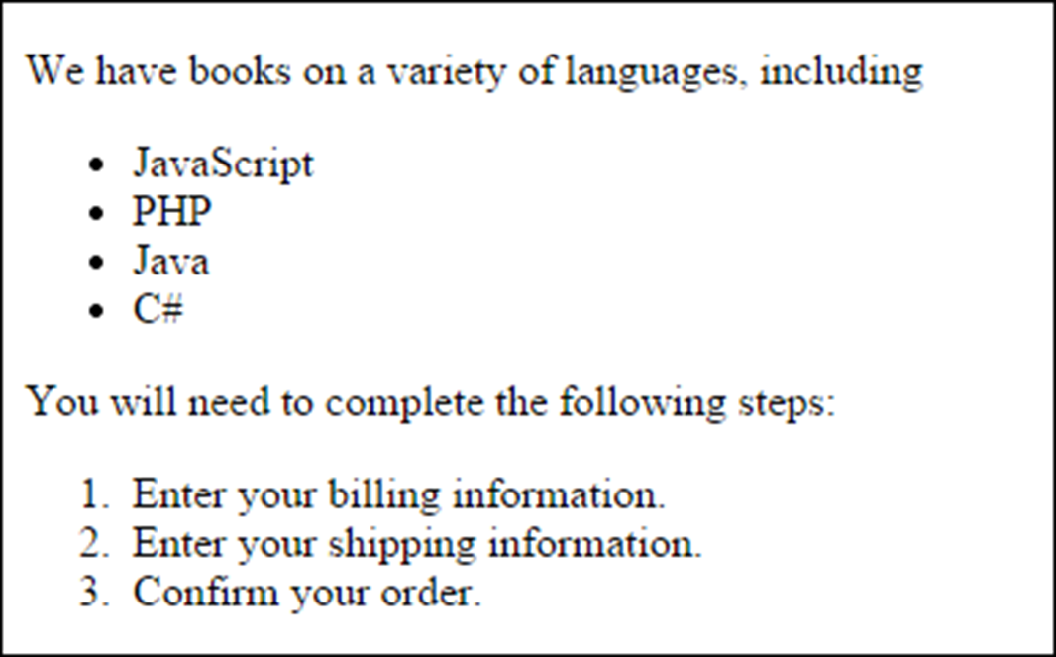
The lists in a web browser

Slide 26

An img element
<img src="images/murachlogo.gif" alt= "Murach Logo" height="75">
<h1>Mike Murach &amp; Associates, Inc.</h1>
The image in a web browser

Slide 27
Common image formats
JPEG (Joint Photographic Experts Group)
GIF (Graphic Interchange Format)
PNG (Portable Network Graphics)
Accessibility guidelines for images
For images with useful content, always code an alt attribute that describes the image.
For images that are used for decoration, code the alt attribute with no value ("").

Slide 28
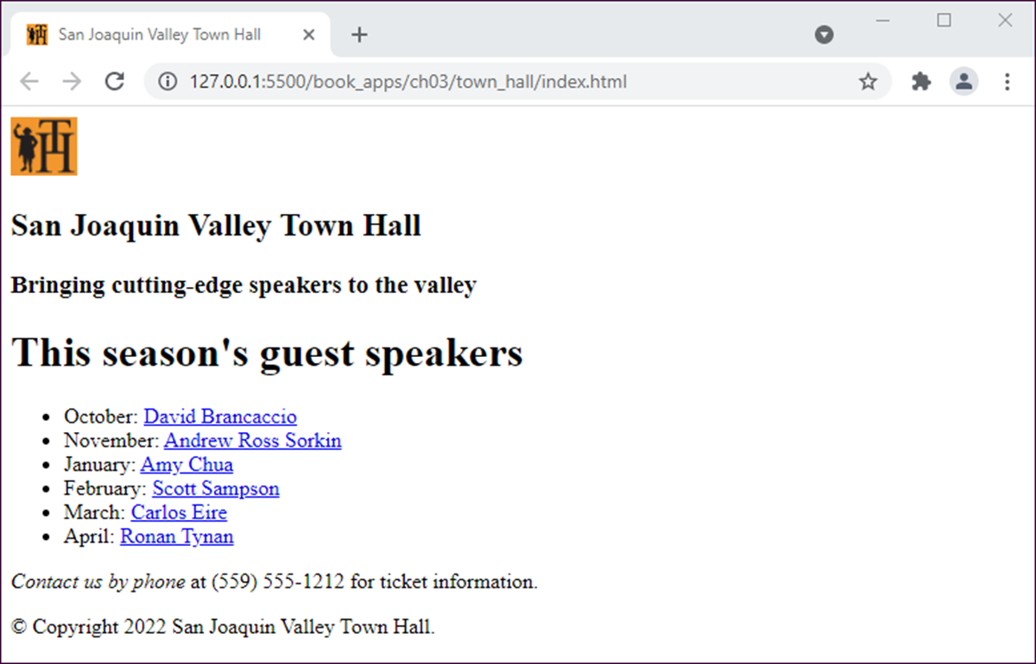
A simple web page

Slide 29
The HTML file for the web page
<!DOCTYPE html>
<html lang="en">
<head>
<meta charset="utf-8">
<title>San Joaquin Valley Town Hall</title>
<link rel="shortcut icon"
href="images/favicon.ico">
</head>
<body>
<header>
<img src="images/logo.jpg" alt="Town Hall Logo" width="50">
<h2>San Joaquin Valley Town Hall</h2>
<h3>Bringing cutting-edge speakers to the
valley</h3>
</header>

Slide 30
The HTML file for the web page (continued)
<main>
<h1>This season's guest speakers</h1>
<nav>
<ul>
<li>October:
<a href="speakers/brancaccio.html">
David Brancaccio</a></li>
...
...
</ul>
</nav>
<p><em>Contact us by phone</em> at (559) 555-1212 for ticket information.</p>
</main>
<footer>
<p>&copy; Copyright 2022 San Joaquin Valley Town Hall.</p>
</footer>
</body>
</html>

Slide 31
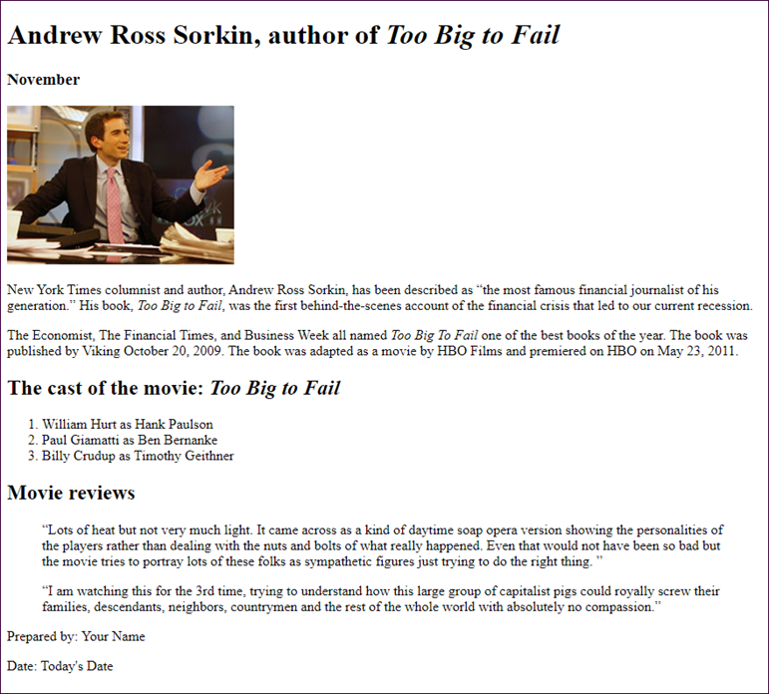
Short 3-1 Create an HTML page

